Slide 1

Analysis of RACH CEPOD utilization by Plastics Department
-QI project-
Supervisor: Ms Greenhowe
Dr Melania Geymonat Ramirez

Slide 2
Analysis of procedures done in RACH CEPOD by Plastics Department
Data gathering: procedures in RACH CEPOD
Data analysis:
  By frequency
  By department
  By type of surgery
  By role of surgeon in charge
  Period: February – March 2024
  Number of patients: 94

Slide 3
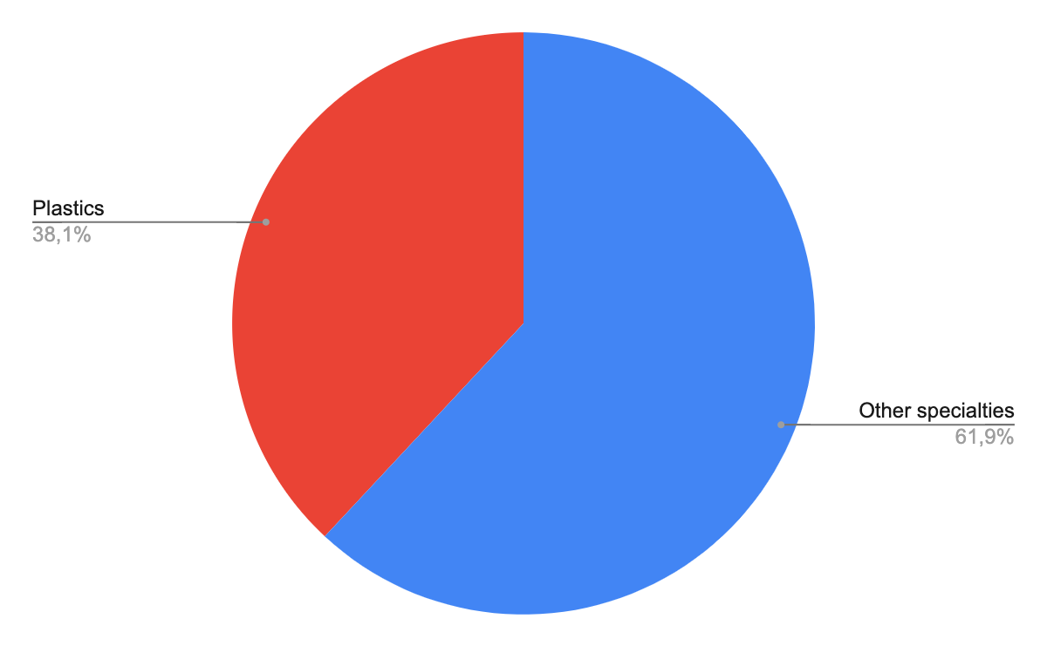
Findings: utilization of RACH CEPOD
Notes:
-Plastics occupies 1/3 of CEPOD time
-2/3 of these procedures are Reg led

Slide 4
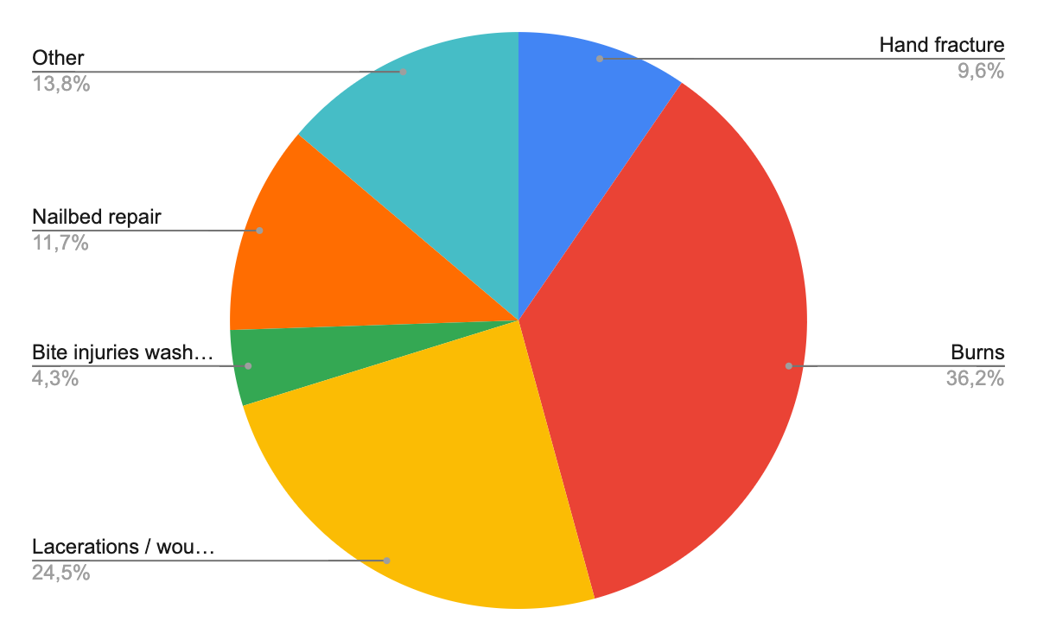
Findings: disaggregation per procedure

Slide 5
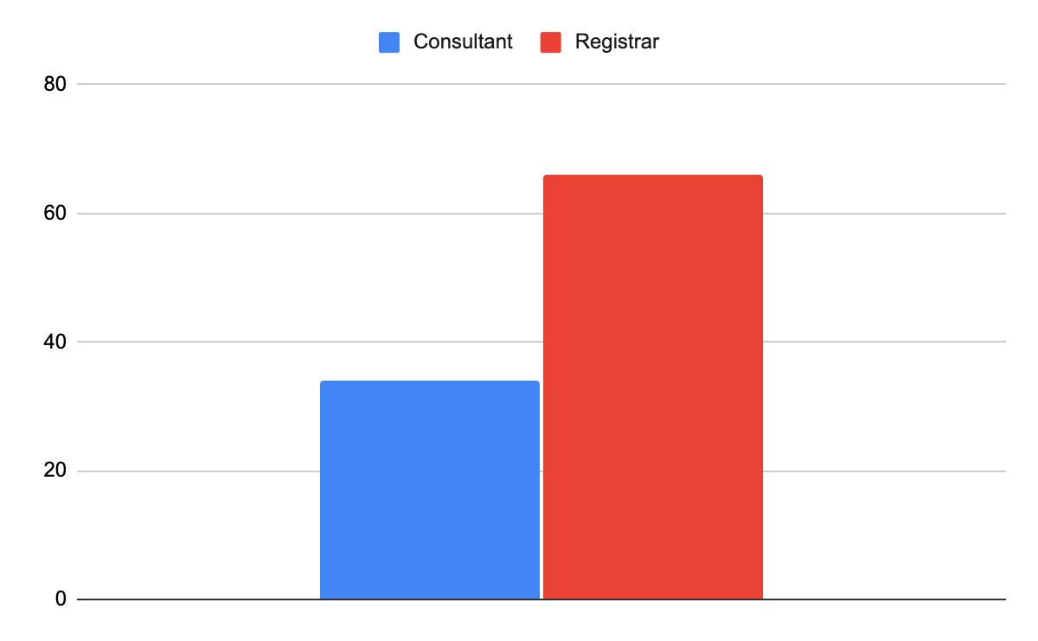
Findings: role of leading surgeon

Slide 6
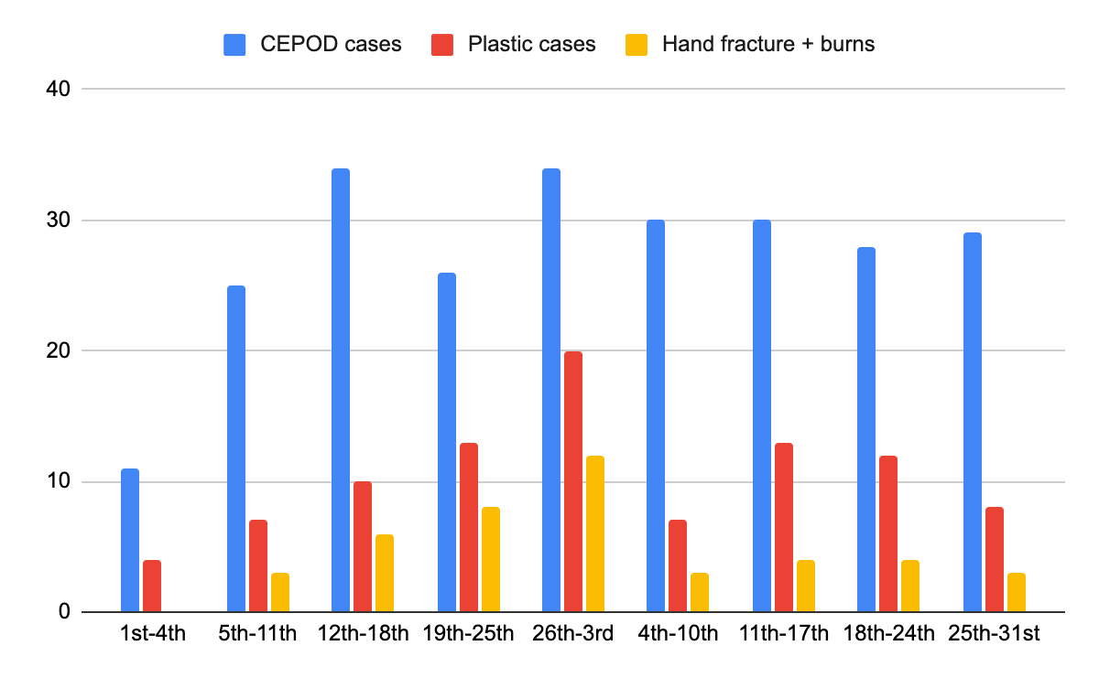
Findings: activity per week

Slide 7
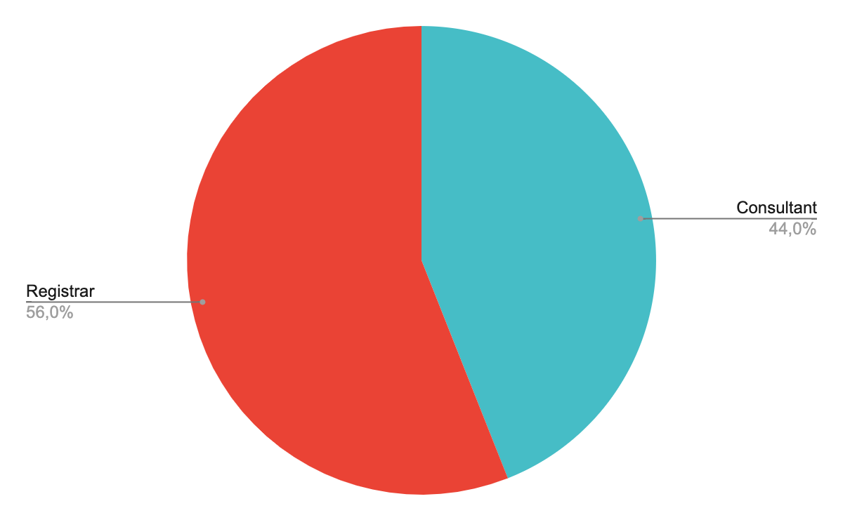
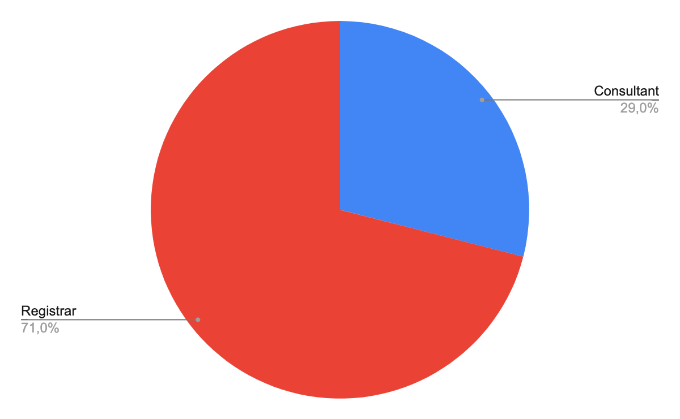
Findings: role of leading surgeon in hand fracture and burns procedures
Hand fractures
Burns

Slide 8
Discussion:
Is the current situation a good standard of care / training?
Can it be improved with more resource allocation?
Should there be an allocated consultant to lead all procedures?
  If not, which ones?
  Is it possible to think of a Consultant allocated two / three mornings per week to lead hand fractures and burns, accommodating other procedures if needed?
Which procedures should be Registrar-led?

Slide 9
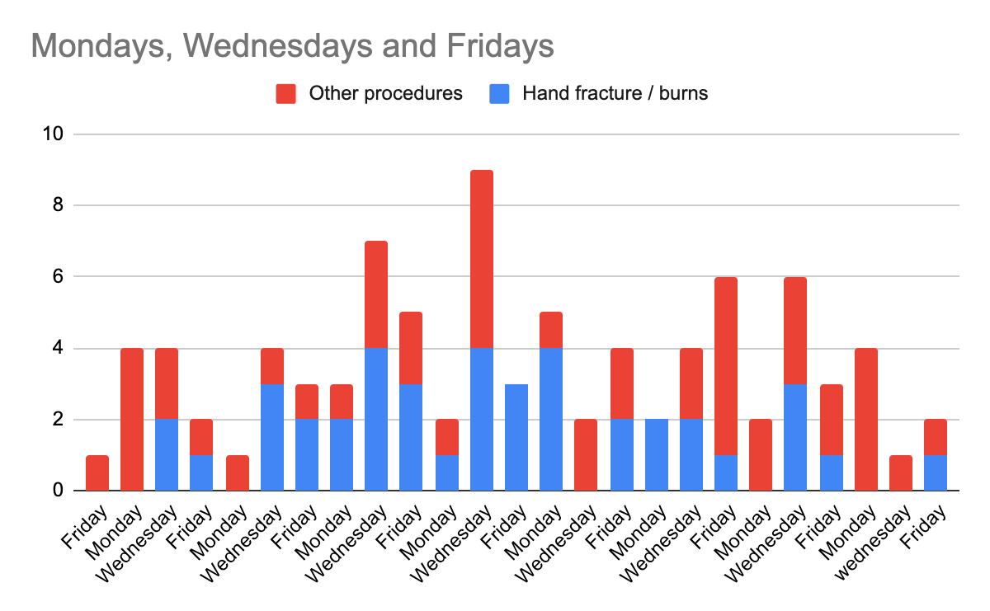
Possibilities: a Consultant allocated e.g three mornings per week

Slide 10
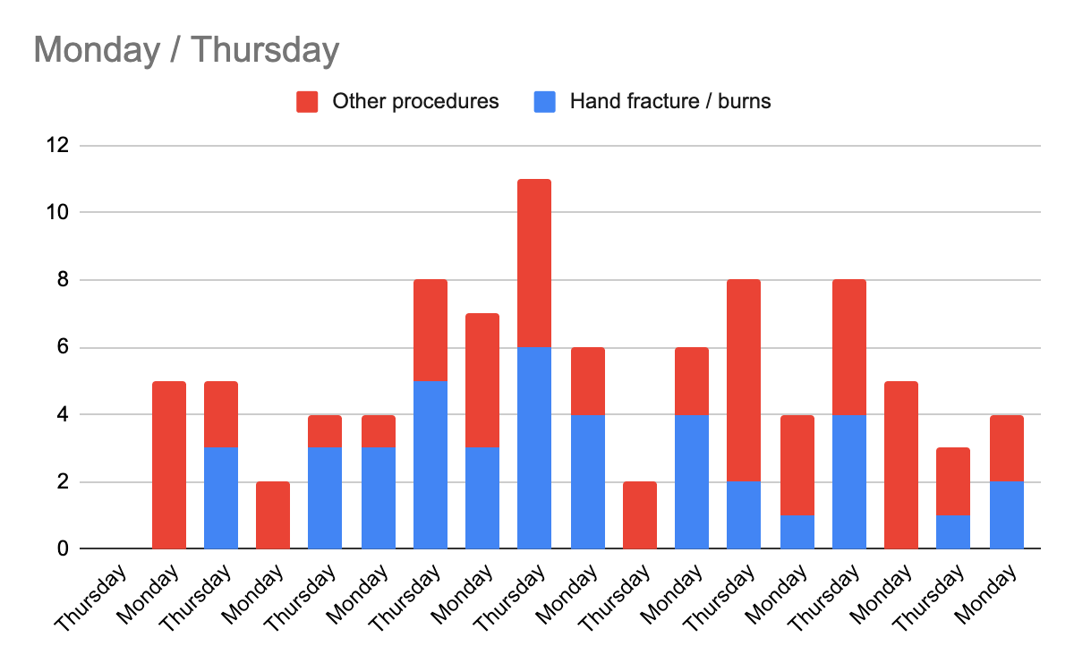
Possibilities: a Consultant allocated e.g. two mornings per week

Slide 11
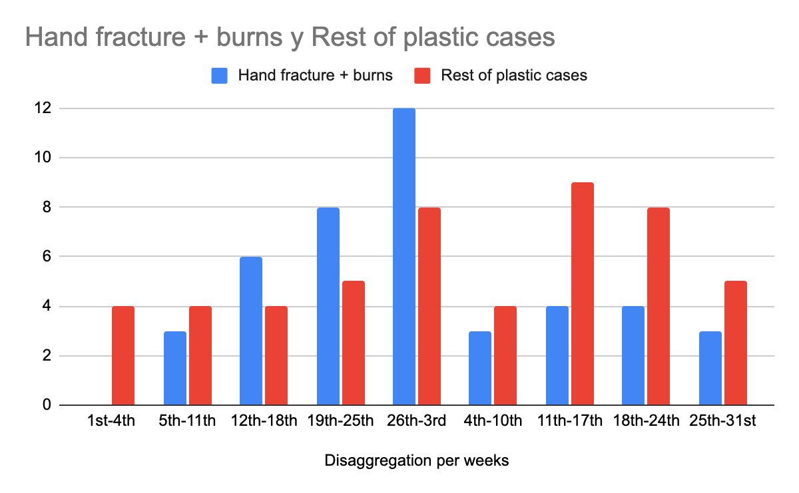
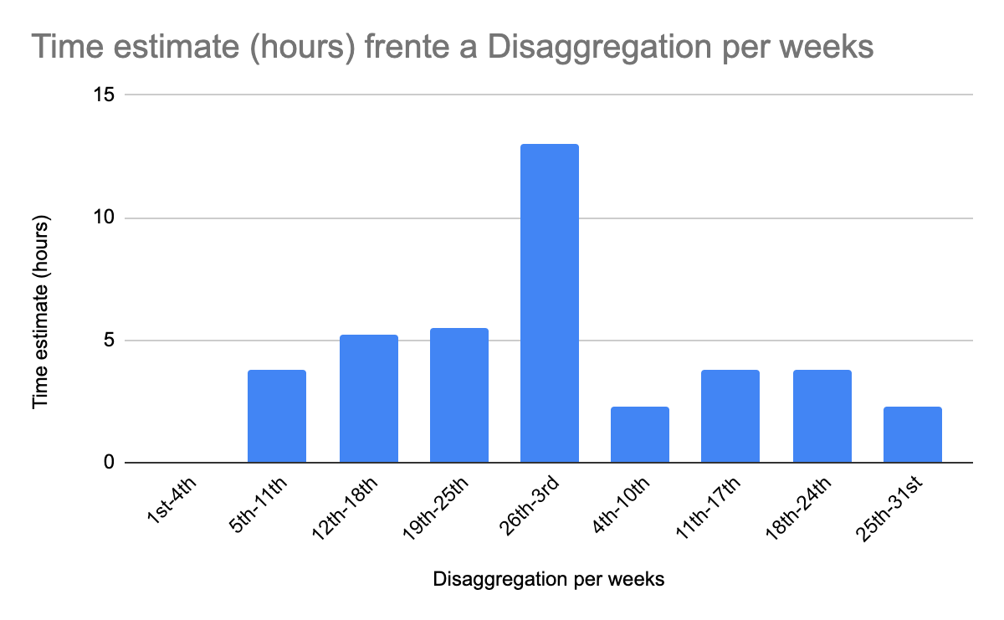
Possibilities
If a Consultant was allocated e.g. two mornings per week:
Notes:
Keeping in mind this has not been done considering the real time each procedure took, but stablishing 45min per burns plus 90 min per fracture as an average.

Slide 12
What is next?
Set standard of care / training
Advocate for more resources if needed
Audit

